Slide 1
Azure

Slide 2
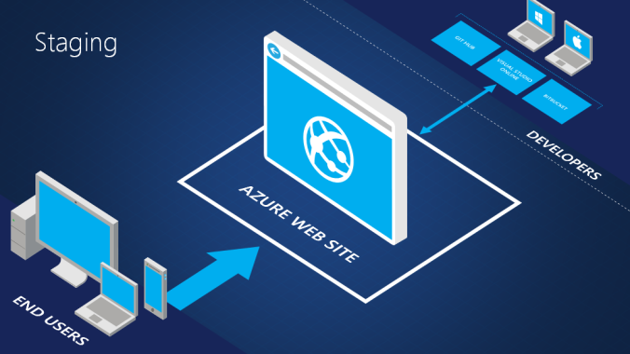

Slide 3
Deployment Slot
A deployment slot is another Web App that runs next to your original one.
Each deployment slot is a full-fledged web app instance.
The original app service deployment slot is called production slot

Slide 4
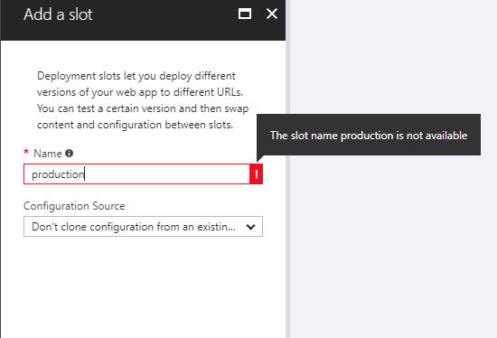

Slide 5
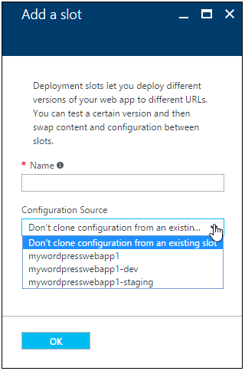
Configuration Source
Configuration that are cloned
General settings - such as framework version, 32/64-bit, Web sockets
App settings (can be configured to stick to a slot)
Connection strings (can be configured to stick to a slot)
Handler mappings
Monitoring and diagnostic settings
WebJobs content
Configuration that are not cloned:
Publishing endpoints
Custom Domain Names
SSL certificates and bindings
Scale settings
WebJobs schedulers

Slide 6
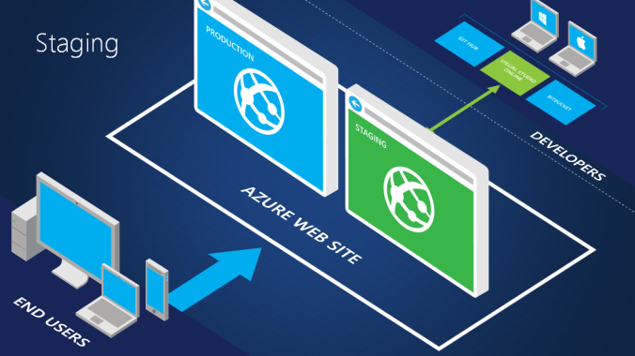

Slide 7
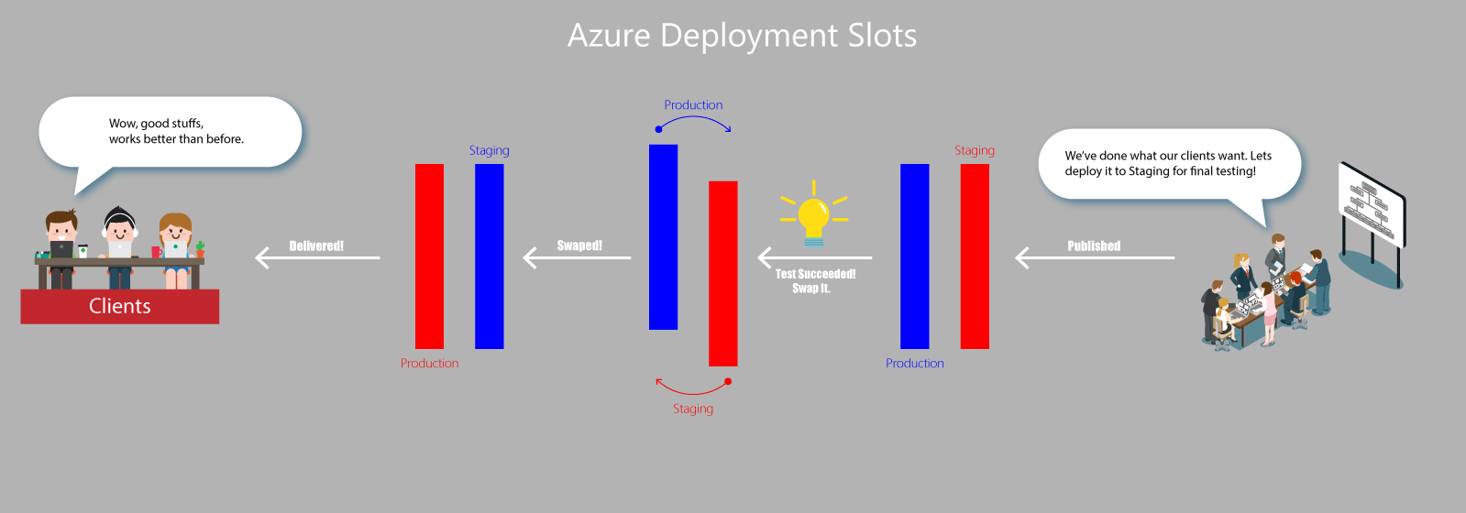

Slide 8
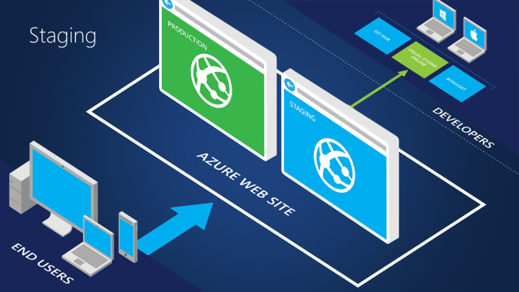

Slide 9
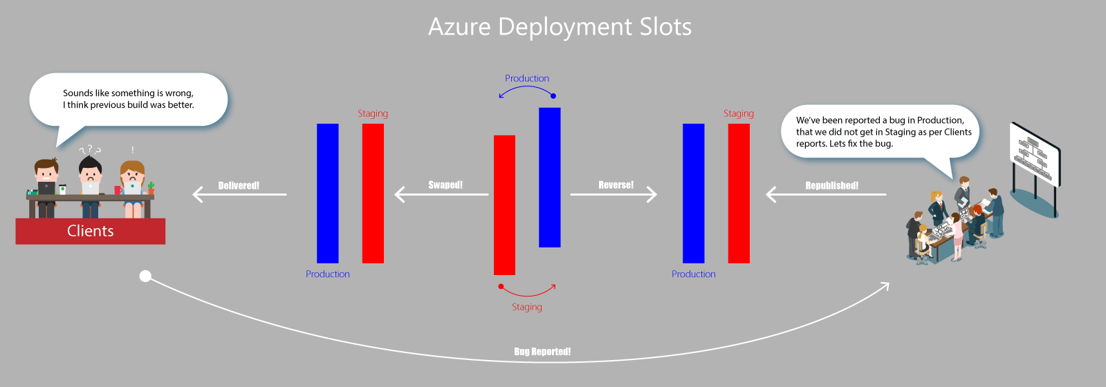

Slide 10
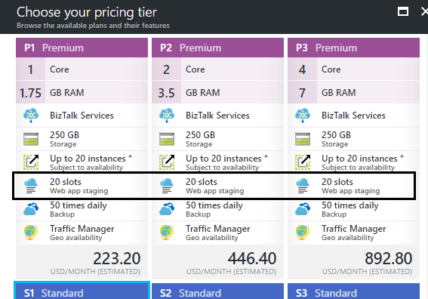
How many ?

Slide 11
Advantages
Test it in pre-production
Easily deploy
Revert deployment

Slide 12
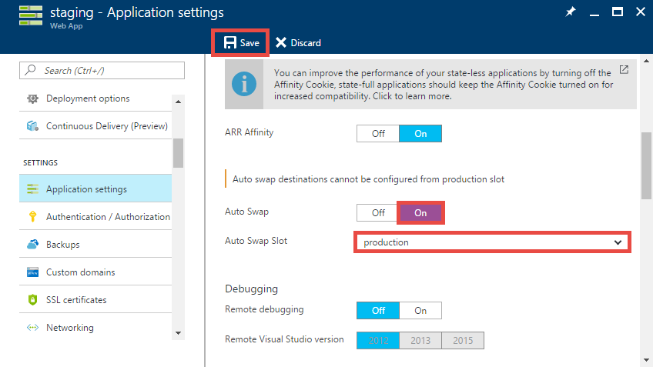
Auto - swap

Slide 13
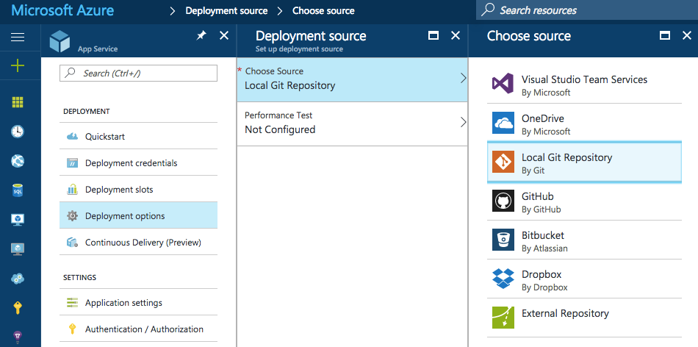
Deployment Options

Slide 14
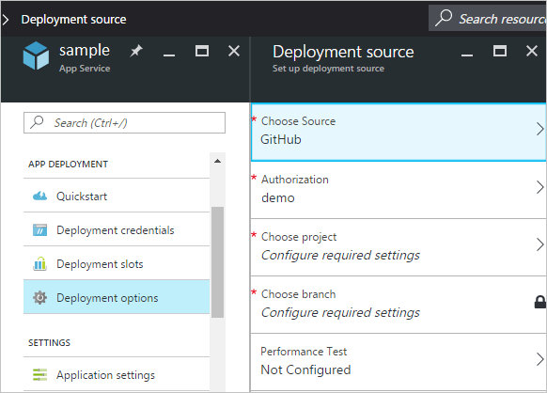

Slide 15
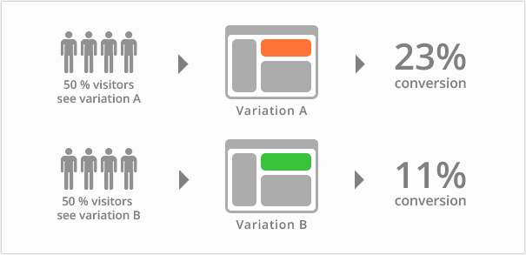
Testing in Production

Slide 16
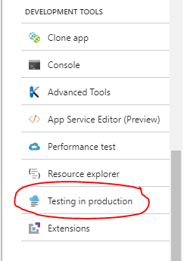

Slide 17
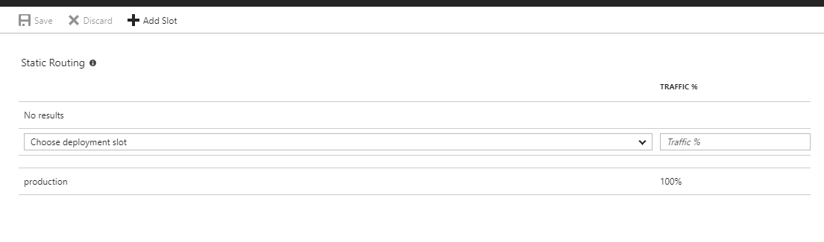

Slide 18
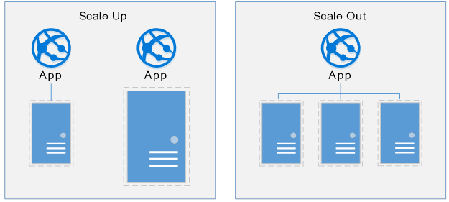
Scaling

Slide 19
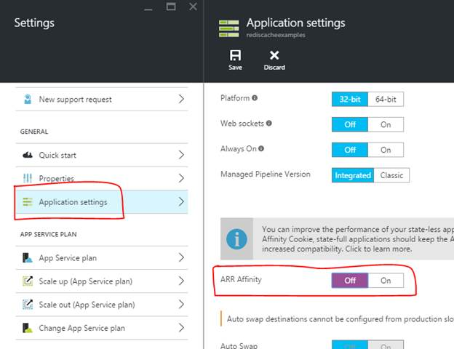
ARR Affinity

Slide 20
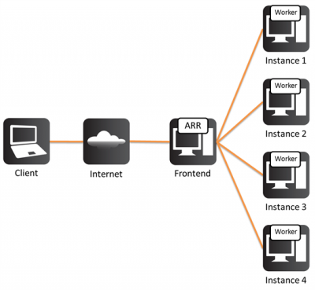
Notes:
Turning off the ARR Affinity will disable the process of creating the cookie ARRAffinity cookie. So, when the cookie is disabled, the requests might be sent to any of the available servers. So, there is no guarantee that the Sessions will be maintained properly. Sessions will work ONLY when the requests are being served from the Same server. If any of the requests are served by another server (instead of the one where the session is stored) then Sessions will be NULL.

Slide 21
Traffic Profile Routing Algorithms

Slide 22
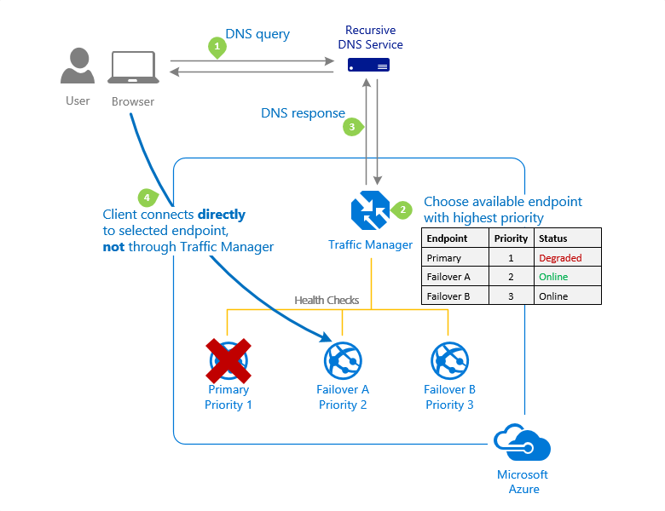
Priority

Slide 23
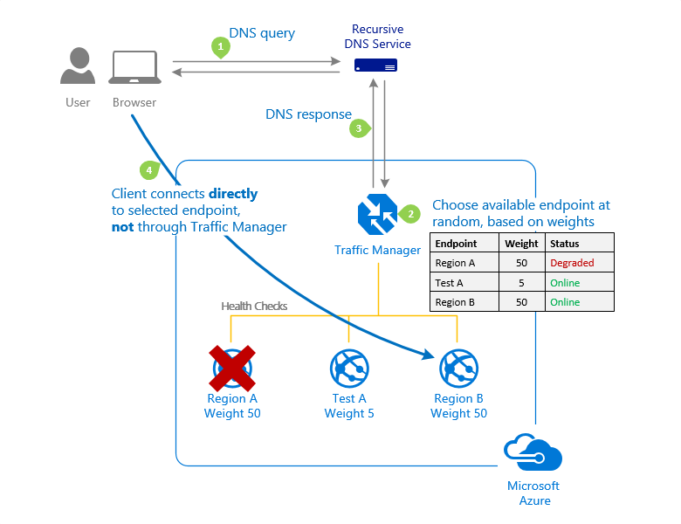
Weighted

Slide 24
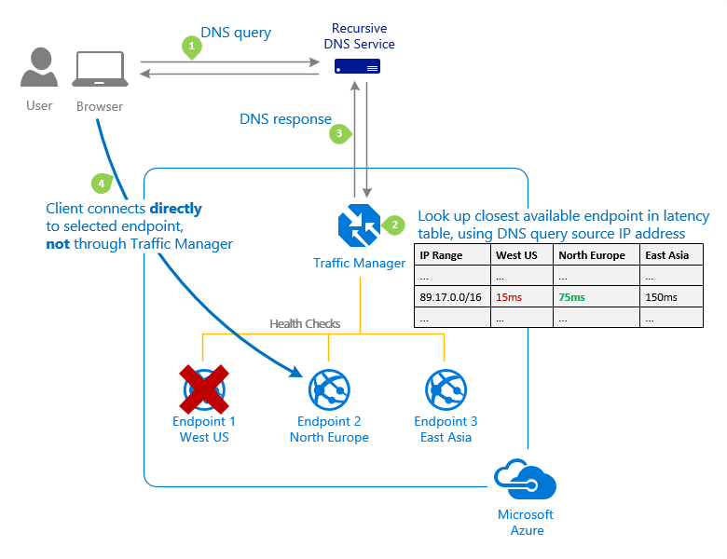
Performance

Slide 25
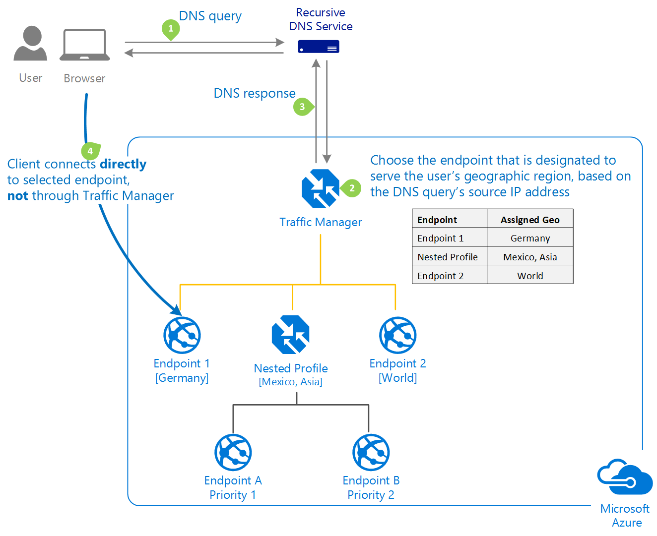
Geographic

